Slide 1
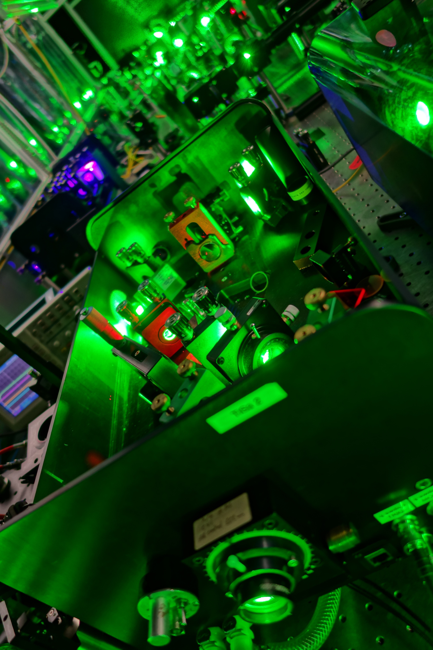




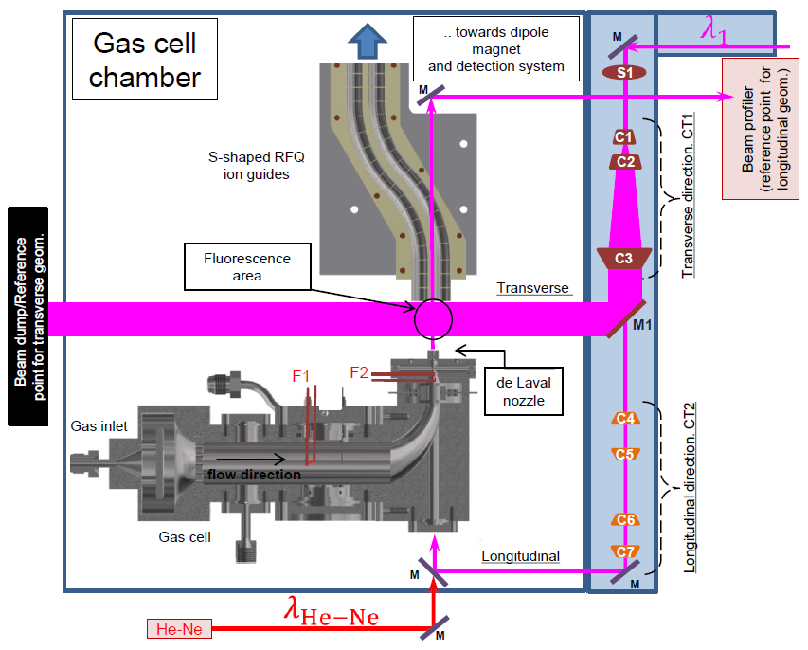
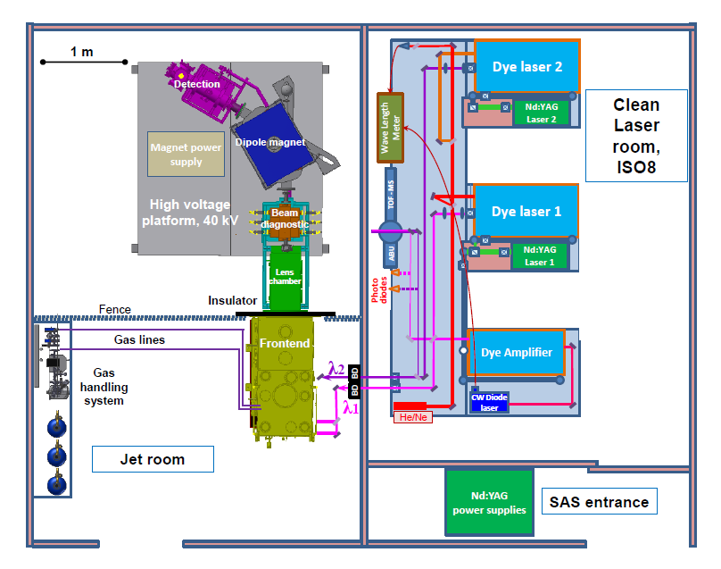
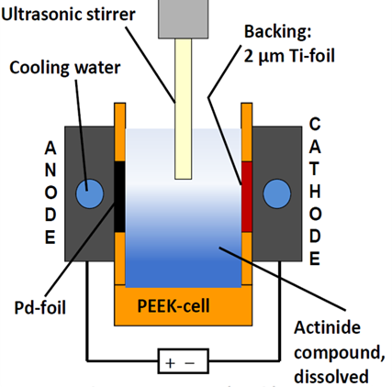
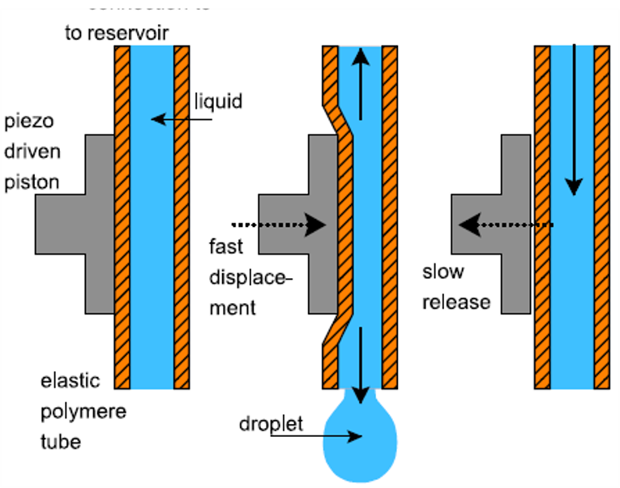
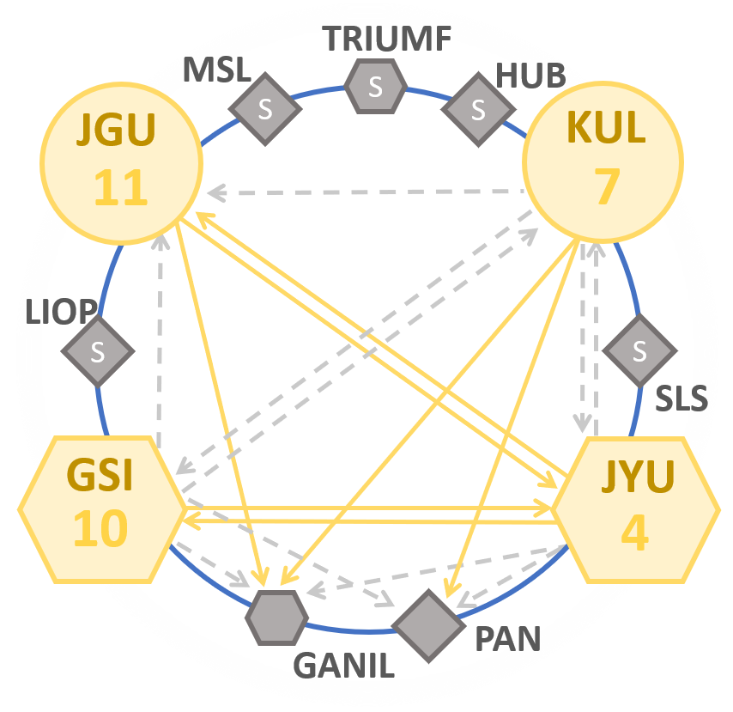
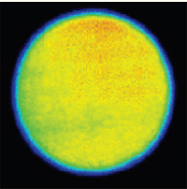
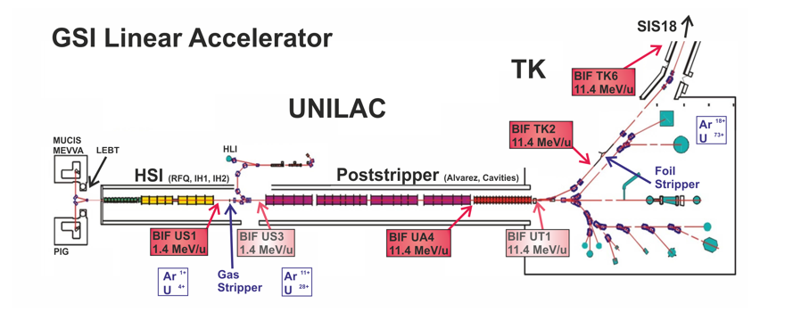
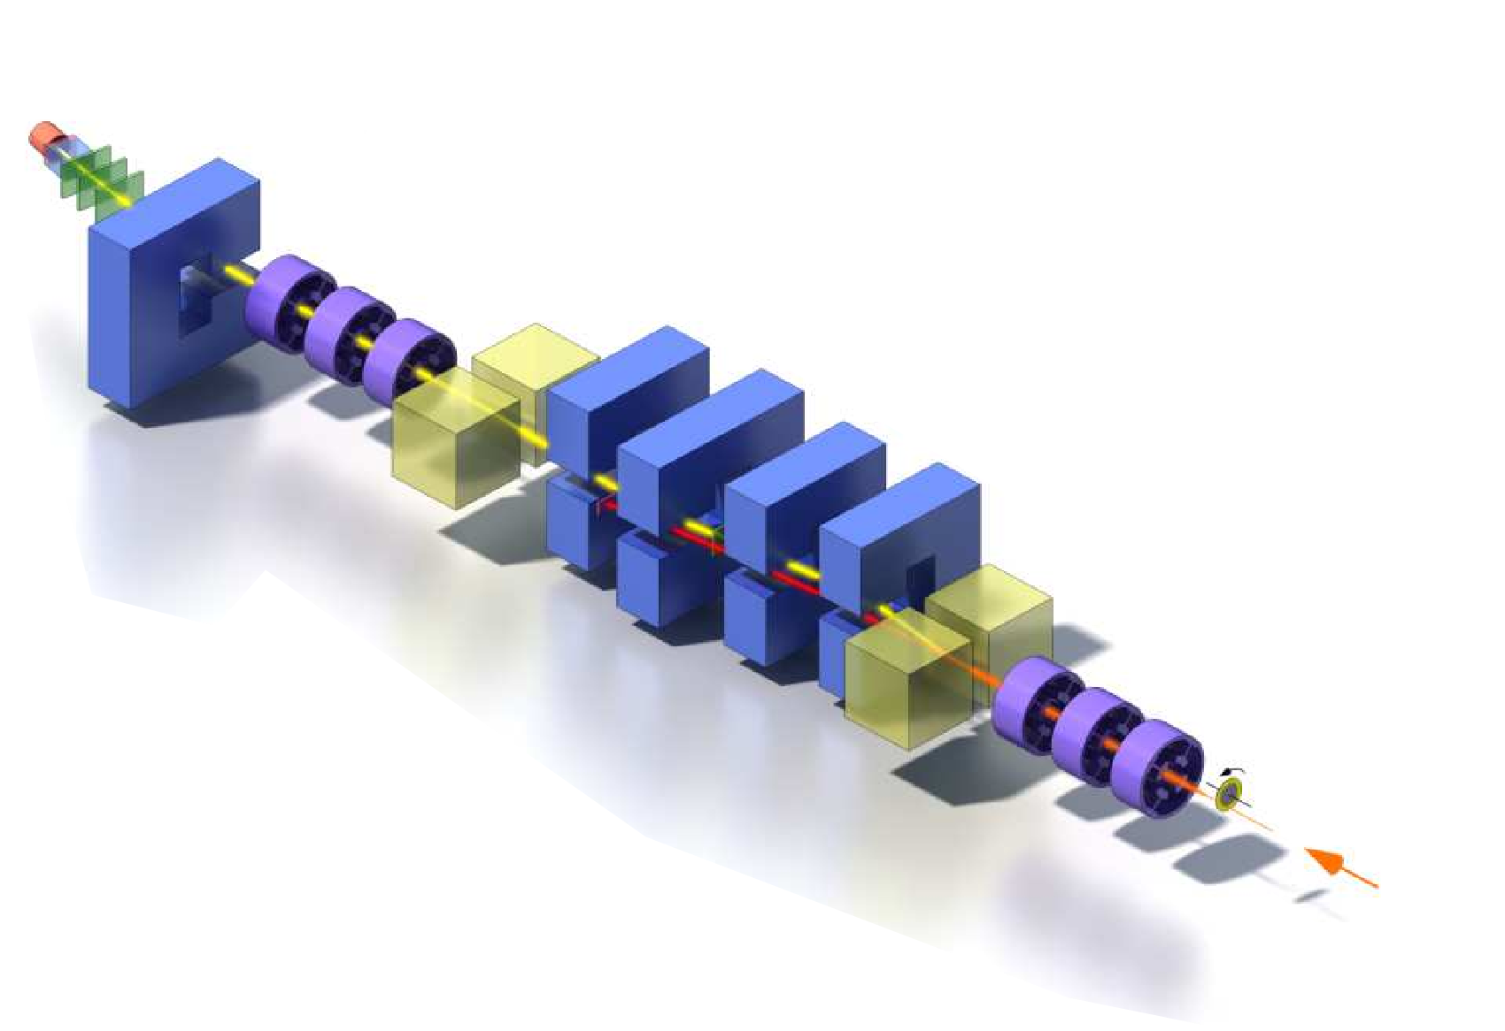

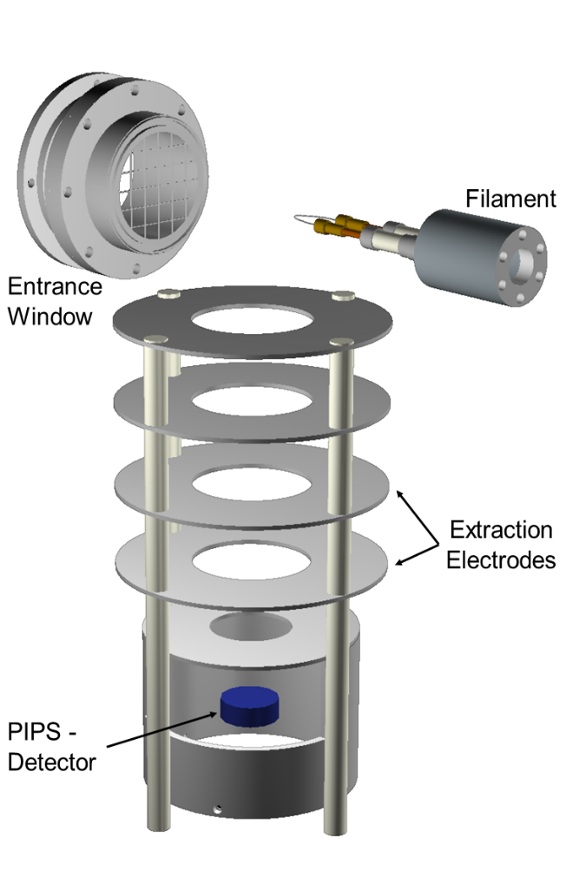
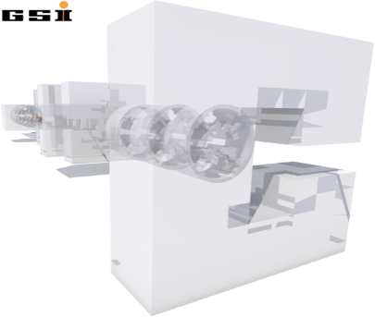
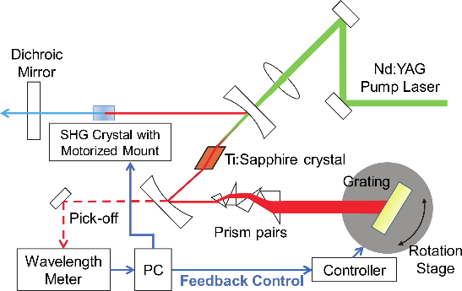
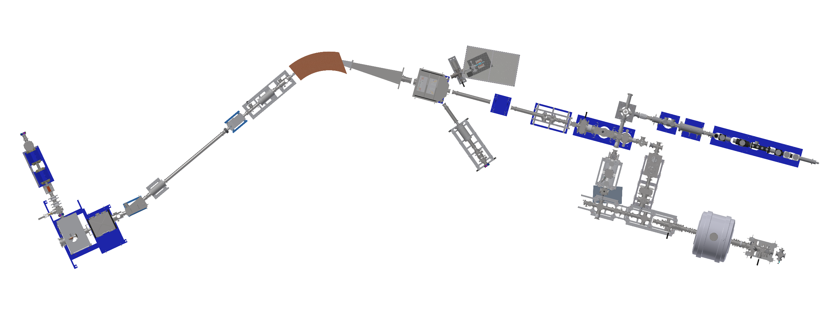
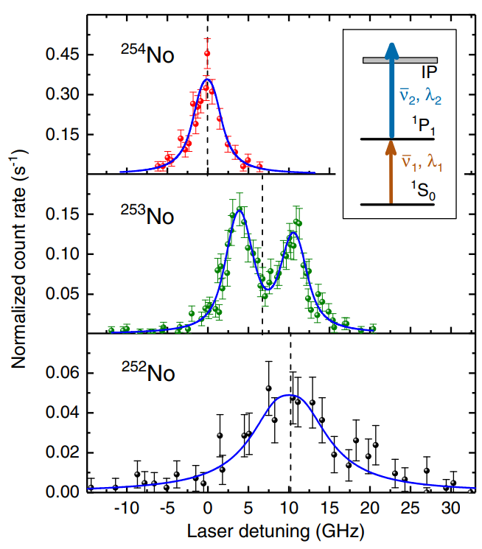
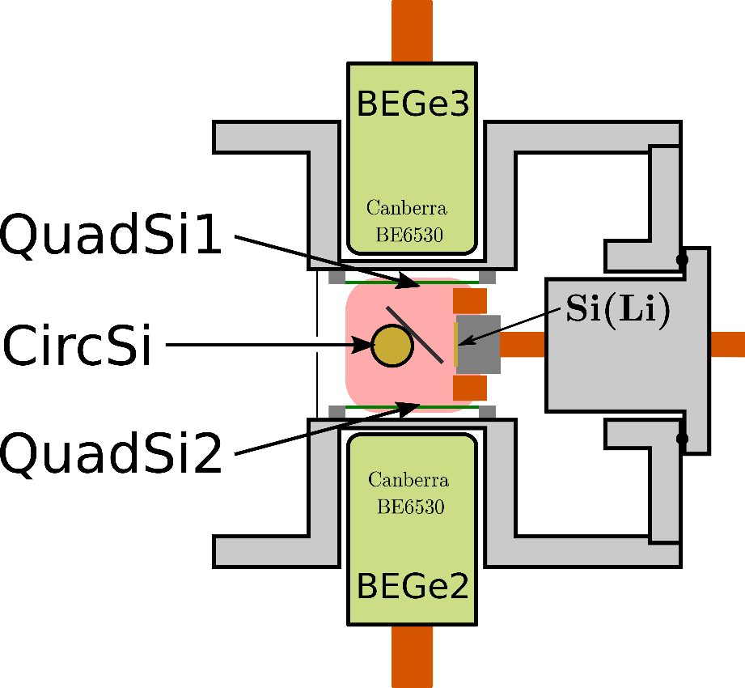

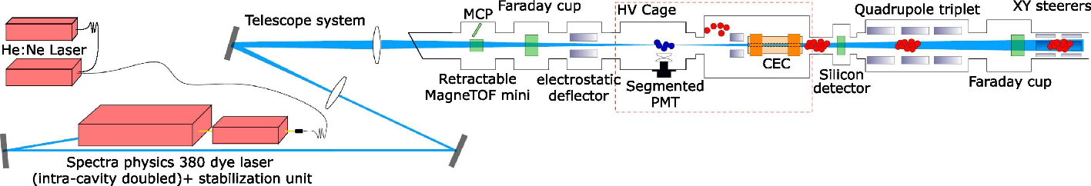

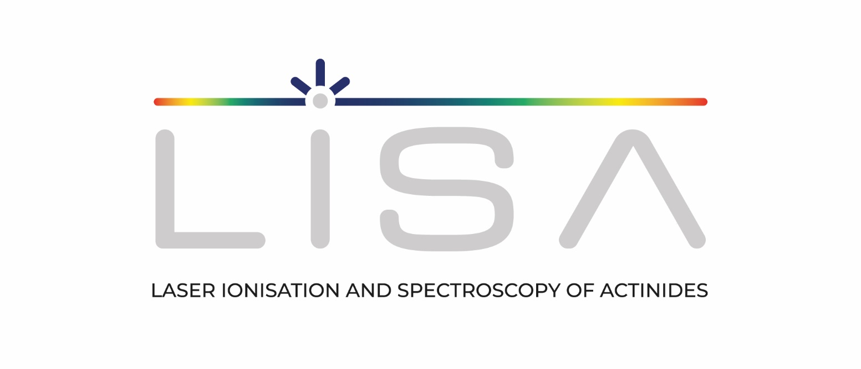

WP5: EXPLORING THE LIMITS OF NUCLEAR EXISTENCE
LISA General Training 1
V. Leask ¹, A. Raggio ², L. E. Reed ³, J. Warbinek ⁴
¹Instituut voor Kern - en Stralingsfysica, KU Leuven, Belgium ²University of Jyväskylä, Department of Physics, Finland ³Department Chemie - Standort TRIGA, Johannes Gutenberg-Universität Mainz, Germany
⁴GSI Helmholtzzentrum für Schwerionenforschung, Darmstadt, Germany
Objectives of WP5
Optimize actinide target preparation and characterization techniques for the LISA network
Characterize and optimize the novel in gas-jet spectroscopy technique for final implementation at GANIL S3
Perform laser spectroscopy using highly sensitive techniques on both actinide and transactinide isotopes to probe atomic and nuclear properties and to benchmark state of the art atomic and nuclear theoretical calculations
Optimized actinide target preparation and characterization
In-gas-jet resonance ionization spectroscopy
Method 1: Electrodeposition
Deposition yields < 90 % [1]
Typically employed
Salt dissolved in an alcohol → Attracted to cathode → Binds to backing electrochemically
Method 2: Drop-on-Demand (DoD) printing
Deposition yields ≥ 97 % [2]
Substrate on xy translation stage
Not electrochemically bound → less stable in beam?
Salt dissolved → Solution inkjet printed on backing → Solvent evaporates leaving salt on backing
5
3
4
Clean Laser
Room, ISO8
2
3
Fig. 1. (Left) Electrodeposition cell set-up [3]
2
1
2
3
1
Fig. 2. (Right) DoD dispensing process schematic [4]
Fig. 5. Layout of gas-cell chamber for planar laser-induced fluorescence measurements [6]
Fig. 4. Layout of in-gas-jet laser ionization spectroscopy laboratory at KU Leuven [6]
Target characterization techniques:
Deposition yields: α- or γ- spec., NAA
Layer growth mechanisms: SEM, AFM
Layer homogeneity: α-spec., radiographic imaging
Chemical composition: XRF, XPS, Raman spec.
1. Target activated by ablation laser, products carried with gas-jet of neutral gas
2. Resonance ionization takes place at intersection of lasers and gas-jet (with product)
3. Laser produced ions are confined and transported through RF ion guides towards dipole magnet
4. Dipole magnet separates isotopes according to mass to charge ratio
5. Isotopically pure beams measured at detection station
Fig. 3. Electrodeposited ²⁴²Pu target radiographic image [5]
Studying the heaviest actinides at GSI
Investigation of fundamental ground state properties at IGISOL
Determine nuclear properties from first laser spectroscopy in the heaviest actinides produced by heavy ion fusion reactions
In-gas-cell laser
ionization [7]
Gas phase chemistry
Investigation of ionization schemes with grating Ti:Sa laser
Challenging, accelerator-based production, low yields,
short lifetimes
Fusion products filtered at SHIP separator @ GSI
Production techniques:
Online -Fusion-evaporation reaction
Offline -In-gas-cell Alpha-recoil source -Heated Actinides filaments
+
Lr
Filament
Radiation Detected-RIS Method
Neutralization on filament
Resonance ionization in gas cell
Selective, efficient detection via α-decay
Fig. 9. SHIP separator [10]
Decay Spectroscopy
Decay modes
Lifetimes
Production yields
α-Decay
For high resolution spectroscopy of
hyperfine structure:
in-gas-jet technique
Fig. 6. Grating-based Ti:Sa laser [8]
High-resolution collinear laser Spectroscopy
Silicon Detector
+
95 mbar Argon
Hyperfine structure -nuclear spins -electromagnetic moments -mean-square charge radii
Fig. 10. Scheme of the RADRIS technique [11]
Octupole deformation in neutron-deficient Th and U
Nobelium
First states only recently determined via RADRIS
Multiple Rydberg states identified
Lawrencium
Atomic structure only known from theory
Low IP: challenging filament desorption
→optimum material identified
Fig. 11. Experimentally investigated resonances of the 1P₁ level of different No isotopes [12]
Fig. 7. Decay spectroscopy station
Fig. 8. Collinear beamline at IGISOL [9]
References
[7] Pohjalainen, I. et al., Nucl. Instr. Meth. Phys. Res. Sect. B, 376 (2016) 233-239.
[8] Tomita, H. et al., Prog. Nucl. Sci. tech., 5 (2018).
[9] De Groote, R. P. et al. Nucl. Instr. Meth. Phys. Res. Sect. B, 463 (2020) 437-440.
[10] S. Hofmann et al.Rev. Mod. Phys. 72 (2000) 733 .
[11] Laatiaoui, M. et al., Nature 538 (2016) 495–498.
[12] Raeder, S. et al., Phys. Rev. Lett. 120 (2018) 232503.
[1] Vascon, A. et al., Nucl. Instr. Meth. Phys. Res. Sect. A, 696 (2012) 180-191.
[2] Haas, R. et al., Nucl. Instr. Meth. Phys. Res. Sect. A, 874 (2017) 43-49.
[3] Runke, J. et al., Radioanalytical Nucl. Chem., 299 (2018) 1081-1084.
[4] BioFluidix GmbH. PipeJet P9 Nanodispenser Datasheet, 2014.
[5] Eberhardt, K. et al., AIP Conf. Proc., 1962 (2018) 030009:1-8.
[6] Zadvornaya A. (2018), Characterization of the spectral resolution of the
in-gas-jet laser ionization spectroscopy method (Doctoral dissertation),
KU Leuven, Belgium.
Download the poster!
This Marie Sklodowska-Curie Action (MSCA) Innovative Training Network (ITN) receives funding from the European Union H2020 Framework Programme under grant agreement no. 861198.
Notes:
***INSTRUCTIONS
Choose high-res picture, preferably dark
Replace it behind the green and blue blocks

